Slide 1
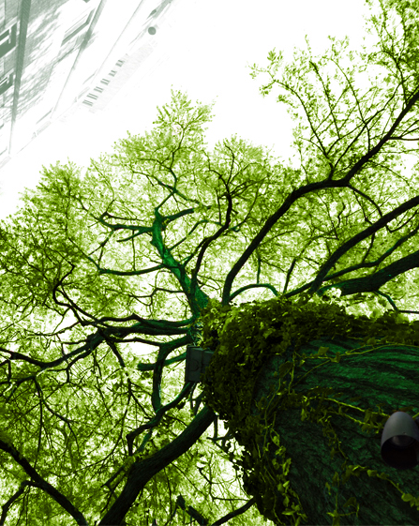
Waste Water Treatment Plants as a part of the Green Gas Hub
Interreg IV a – Groen gas / grünes Gas
Drs Bauke de Vries
Ir Willem Brus
Ir Ralph Lindeboom
Prof. Dr. Johan Wempe
Ir. Jan de Wit
Onno van Teijens, Alieke de Jong, Laura te Nijenhuis, Pim Slottje, Max Kroes, Pim Slotje

Slide 2
structure
Project aims
Partners & roles
Subproject Echten (Water Board Reest & Wieden)
Subproject Goor (Water Board Vechtstromen)
Subproject Emsdetten (INFA / Kläranlage Emsdetten
Overall conclusions, questions, discussion

Slide 3
Project aims
Integralen Konzept für Kläranlagen als Grüngas-Produzenten
Optimierung Energieproduction
Entwicklung von Wissen – Grüngas und Kanalreinigung
Chancen für neue Unternehmen
Errichten regionale Energiebetriebe

Slide 4
Partners and subprojects
Saxion University of Applied Sciences – project leader; support research work
Waterschap Reest en Wieden – improvement biogas production WWTP Echten
Waterschap Vechtstromen – biogas from manure and grass in sludge digester Goor
Kläranlage Emsdetten / INFA – cosubstrate use in sludge digester Emsdetten

Slide 5
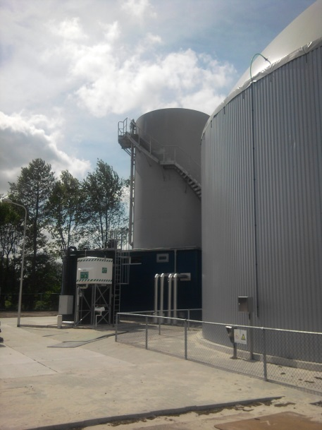
Biogas production Echten
Water Board Reest en Wieden
Waste Water treatment plant
Installed new reactor to produce biogas from own sludge AND sludge from other WWTP’s

Slide 6
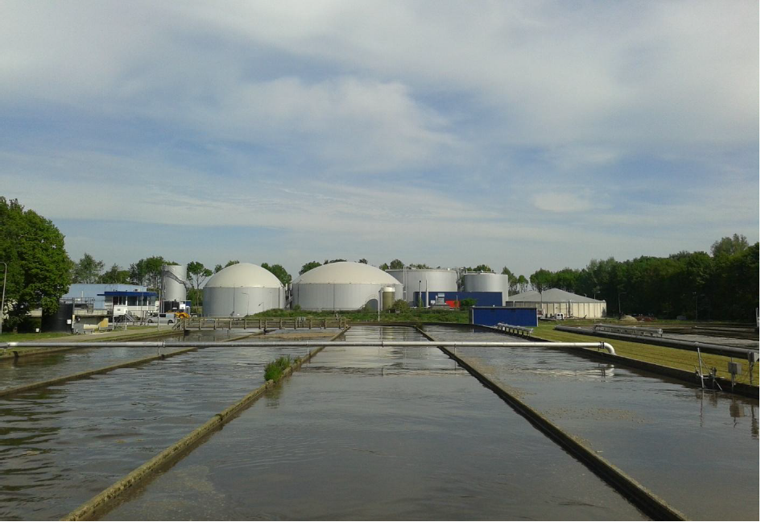

Treatment plant and digester

Slide 7
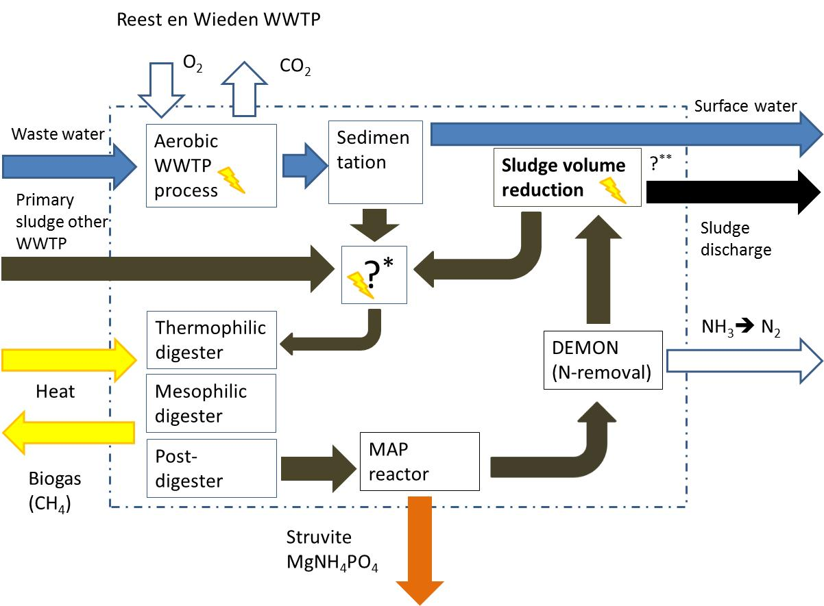
Process flow diagram

Slide 8
aims
Reduce sludge discharge
Increase energy production from waste water and sludge
Use sludge as raw material for biobased products
Increase nutrient recovery (P → struvite)
If appropriate: sell surplus of gas / heat / electricity; run WWTP with other renewable energy sources (wind, pv, geothermy?)

Slide 9
Current situation
Heat & electricity: 2 CHP-units using biogas
Thermophilic digestion at 55 °C
Mesophilic digestion at 35 °C

Slide 10
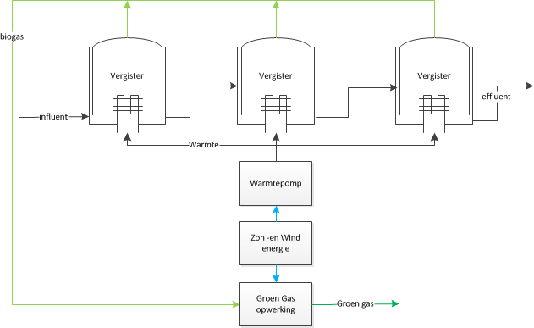
Preferred situation
Other ways of generating heat & electricity
Lower biogas-usage
Refining biogas to natural gas

Slide 11
activities
Comparison pretreatment technologies (laboraty scale – high voltage; TPH; ultrasound)
Test of selected technologies on real life scale
Make energy and mass balance
Explore options for renewable energy production

Slide 12
results
Increase of biogas production as a result of pretreatment (laboratory scale)
Serious plans for pretreatment technology on real life scale; decisions in december

Slide 13
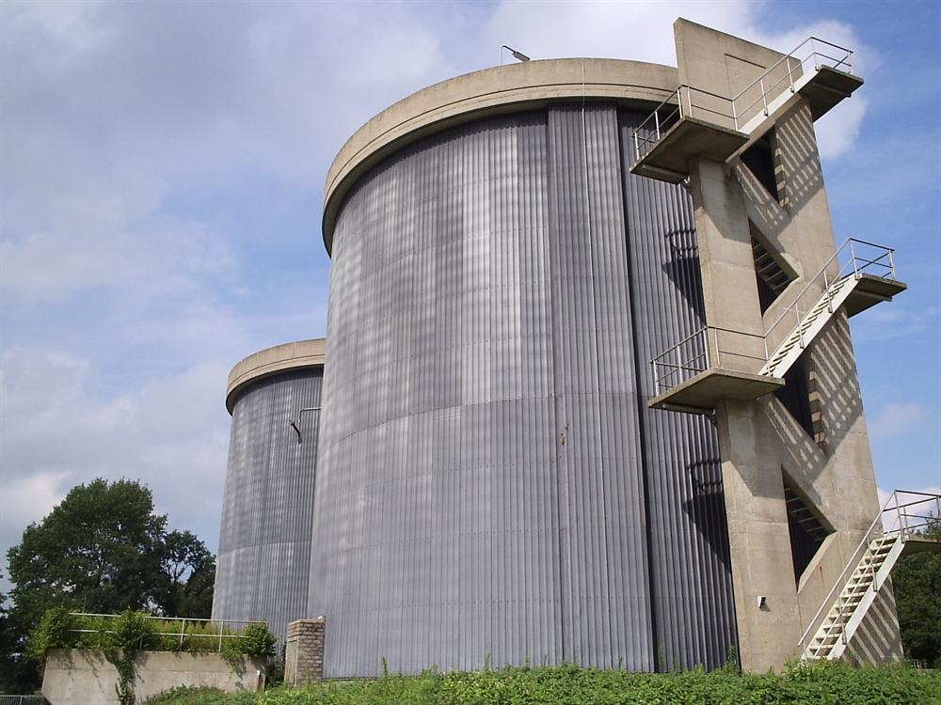
Water board Vechtstromen manure digestion in Goor

Slide 14
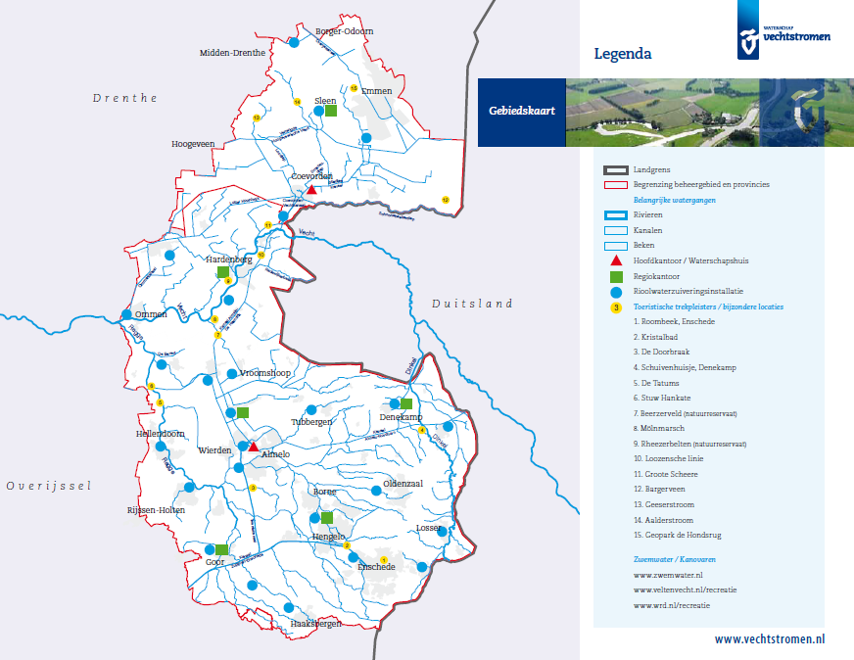
context

Slide 15
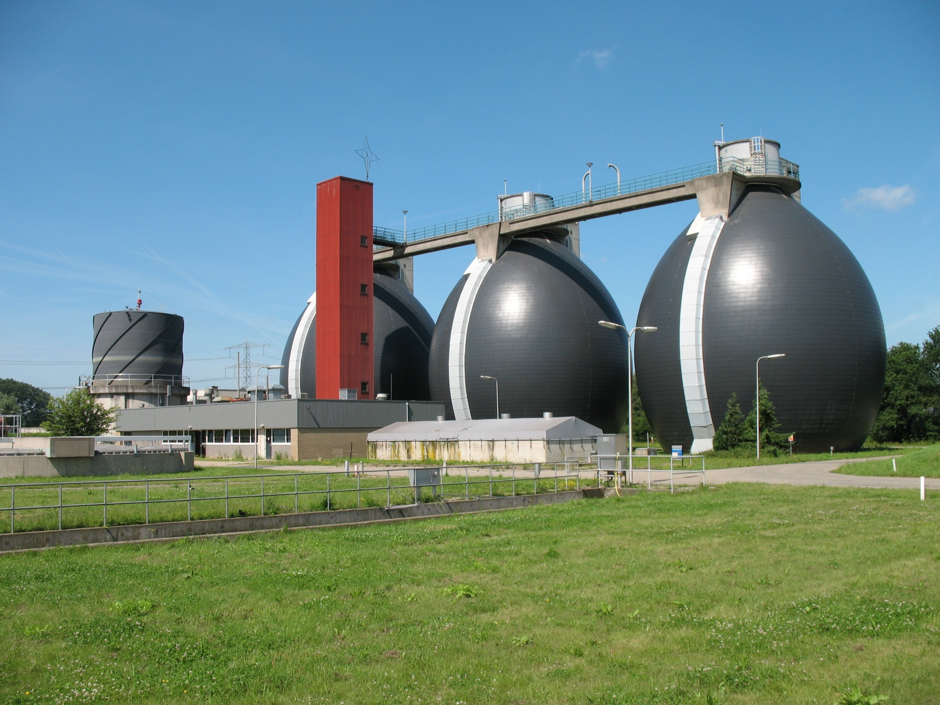
context
Centralisation of sludge digestion in Hengelo
Digestion capacity in Goor available for other purposes
Local surplus of manure and grass from road verges

Slide 16
aims
Investigate technical feasability of sludge digester for manure / grass
Investigate environmental impact on carbon and nutrient cycles
Investigate costs / benefits of new situation
Investigate legal impacts of sludge digestion / gas production by Water Board
Compare options for gas use

Slide 17
Results / progress
Manure / grass applicable in digester, with limited technical adaptations
Impact on carbon and nutrient cycles: research under progress
Legal impacts: research in stage of preparation
Costs / benefits and options for gas: to be executed

Slide 18
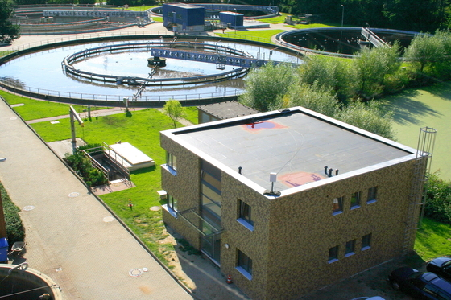
INFA / Kläranlage Emsdetten

Slide 19
aims
Identify options for cosubstrates in sludge digester
Identify local availability of flows of organic waste
Estimate costs and benefits of different options:
  Use free capacity in existing digester / microgasturbine
  Build extra digester / turbine
  Use washwater from Biodiesel production as cosubstrate in existing digester

Slide 20
results
Costs / benefits of filling up unused capacity: 18.000 / 22.000 Euro/ year
Costs / benefits of installing extra microgasturbine: 88.000 / 110.000 Euro / year
Expected benefits of use of biodiesel wash water in digester: 25.000 Euro / year

Slide 21
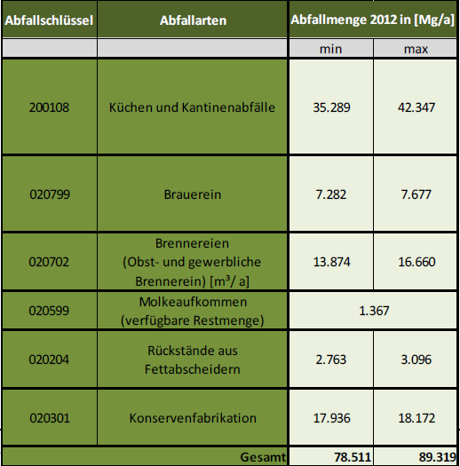
Estimates of available amounts of cosubstrate

Slide 22
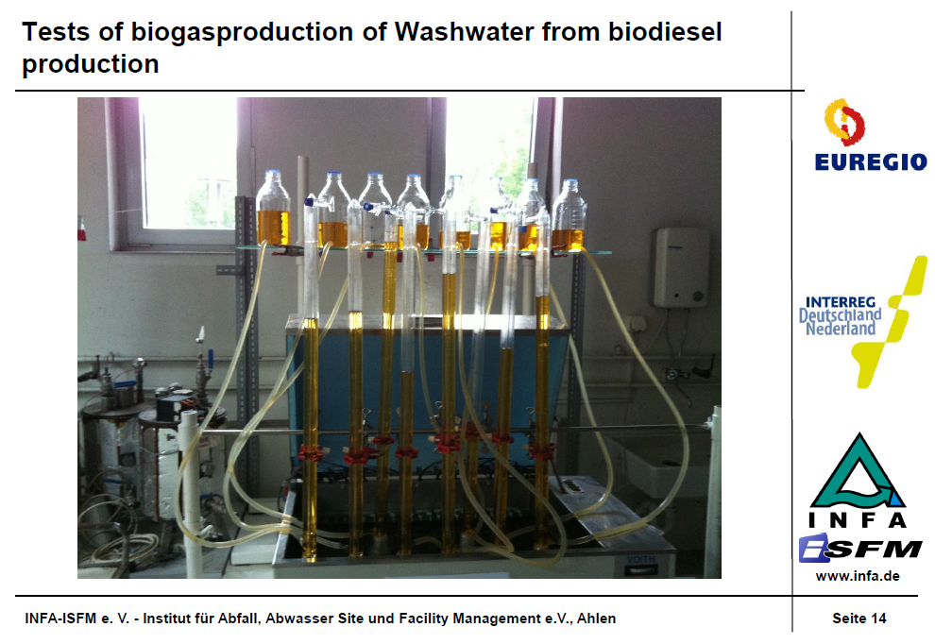

Slide 23
Crucial conditions
Long term availability of cosubstrate
Long term guarantee of electricity price

Slide 24
Project aims - reflection
Integralen Konzept für Kläranlagen als Grüngas-Produzenten
Optimierung Energieproduction
Entwicklung von Wissen – Grüngas und Kanalreinigung
Chancen für neue Unternehmen
Errichten regionale Energiebetriebe

Slide 25
Final conclusions; questions; discussion
Many options for additional energy production from biomass (sludge pretreatment; cosubstrates; other substrates)
Use the energy within the treatment plant, or sell energy / gas and find other renewable energy source? Is green gas the best option?
Nutrient recovery – still in its infancy – influenced by differences in national legislation

Slide 26
Contact information
b.j.devries@saxion.nl
W.m.brus@saxion.nl
R.e.f.lindeboom@saxion.nl
J.f.d.b.wempe@saxion.nl
J.b.dewit@saxion.nl
H.geerse@reestenwieden.nl
J.jogems@vechtstromen.nl
boening@infa.de

